Slide 1
Assignment Output

Slide 2
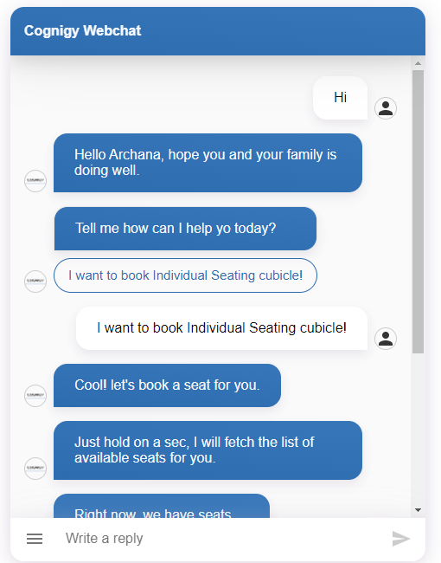

Personalized message via API
Menu option to prompt the user with obvious features
Wait time in between the conversation to make it more human like

Slide 3
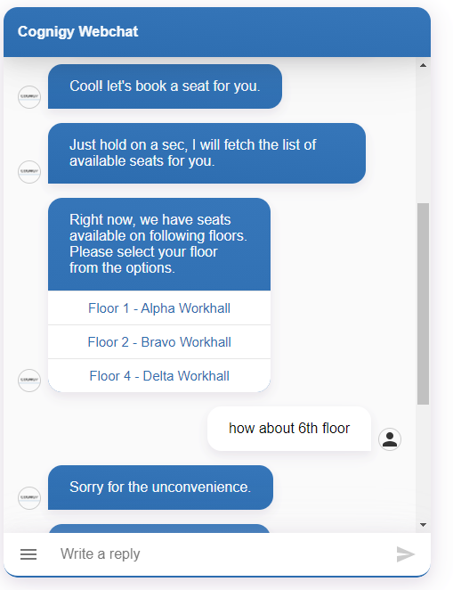
Text with buttons for quick selection
Outside value handling

Slide 4
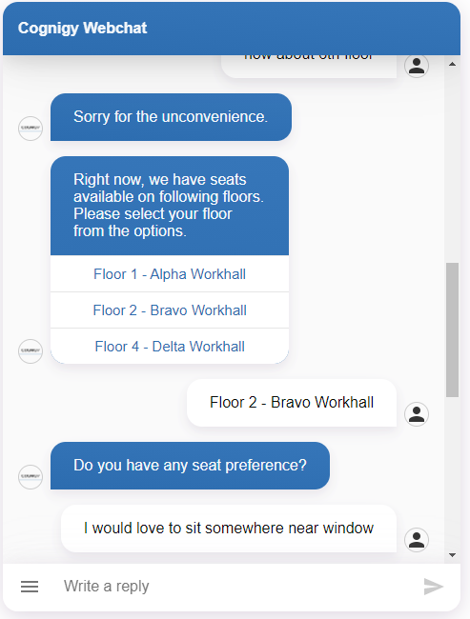
Using entity extraction for identifying any probable seat preference

Slide 5
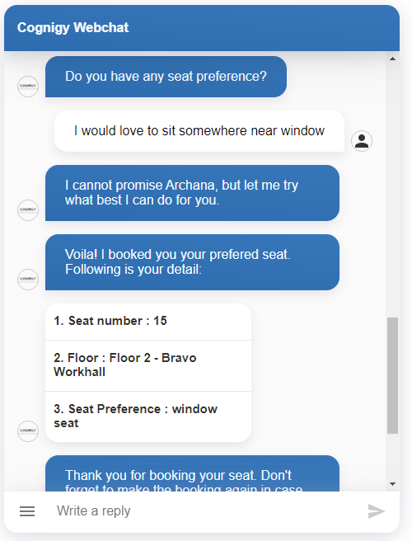
Structured output for clear visibility of information collected and for future reference

Slide 6
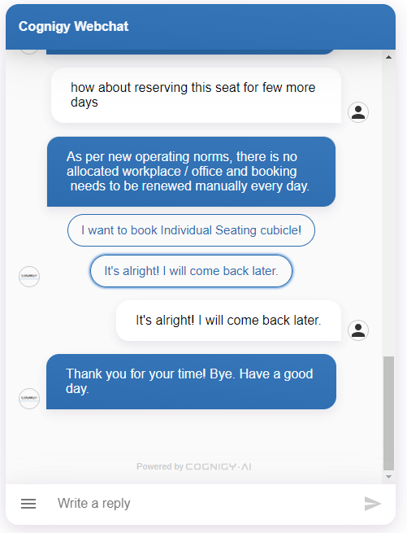
Company norms are checked

